Slide 1
CES 361
Fundamentals of Software Testing
Session 5
Boundary Value Testing

Slide 2
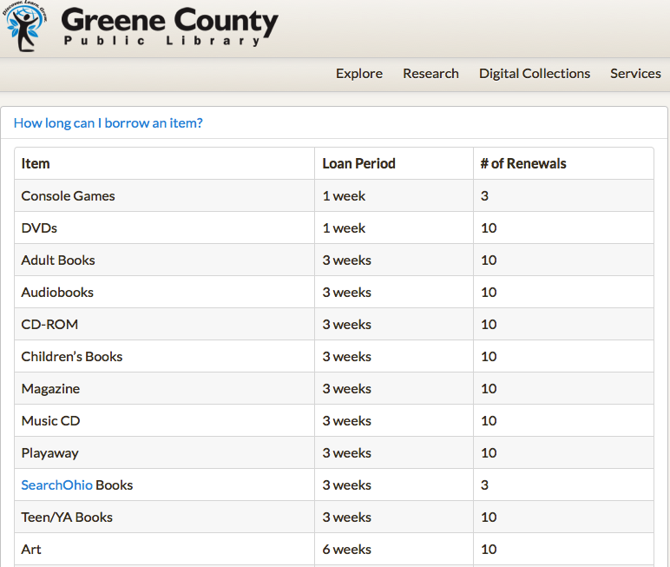
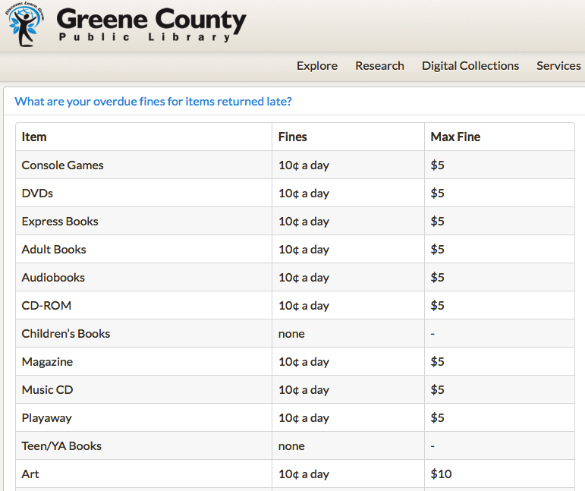
Scenario: Library Checkout Program
How long can I check out an item from the library?
How much will it cost if I return it late?
Answer: It depends on the item type...
Answer: It depends on the business rules...

Slide 3
Scenario: Library Checkout Program
Library Checkout Requirements
The library has three types of materials:
Books, Movies (DVDs), Music (CDs)
2. Length of checkout times are:
Books get checked out for three weeks
Music is checked out for two weeks
Movies are checked out for one week
3. Fines of overdue materials are:
Books: 10¢ per day
Music: 25¢ per day
Movies: 50¢ per day
4. Patrons with accumulated fines of over $5
may not check out any more materials
5. Patrons under the age of 13 may only check out G-rated DVDs
Patrons under the age of 17 may not check out R-rated DVDs
Patrons under the age of 16 may not check out CDs with explicit lyrics
What is the first question
I am going to ask you?
Which requirements
are we testing?
Your mission is to test when program refuses a checkout request

Slide 4
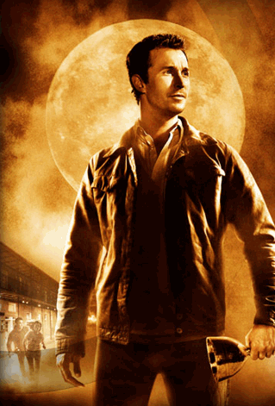
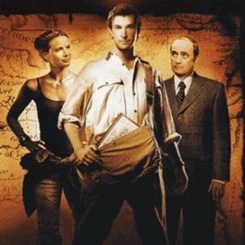
What is boundary analysis?
$5.⁰⁰
fines
REQUIREMENT:
Patrons under the age of 17 may
not check out R-rated DVDs.
13
16
17
age
How many kinds of patrons are there?
So, which ones should go in
the test plan?
Which fines are we interested in?
Which ages are we interested in?
I like 16 and 17, too.

Slide 5
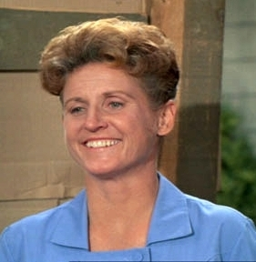
Components of a Test Plan
$5.⁰⁰
fines
REQUIREMENT:
Patrons under the age of 17 may
not check out R-rated DVDs.
13
16
17
age
TEST CASE 2
TEST CASE 1
Input:
Expected Output:
John Davis attempts to check out Platoon
Kimberly Paxton attempts to check out Platoon
System allows checkout
System refuses checkout request (age violation)
Preconditions:
The current date is Dec 15, 2015
A patron named Kimberly Paxton (DOB: Dec 16, 1998) exists
A patron named John Davis (DOB: Dec 15, 1998) exists
A DVD entitled Platoon (rated R) is available for checkout

Slide 6
How this looks in the Test Plan
Preconditions:
The current date is Dec 15, 2015
16, 2015
HINT: Preconditions
can be specified
for a single test
case, or for several test cases.
A patron named Kimberly Paxton (DOB: Dec 16, 1998) exists
with one item checked out (Guardians of the Galaxy DVD, due Dec 15 2015)
with existing outstanding fines of $4.⁵⁰
$5.⁰⁰
A patron named John Davis (DOB: Dec 15, 1998) exists
A DVD entitled Platoon (rated R) is available for checkout
Input:
Expected Output:
Kimberly Paxton attempts to check out Platoon
System refuses checkout request (age violation)
allows checkout
Postconditions:
The DVD entitled Platoon (rated R) is still available for checkout
Patron Kimberly Paxton checkout data remains unchanged

Slide 7
What is boundary testing?
WHICH BRINGS US BACK TO...
Sandy Waters
$5.⁰⁰
Kim Paxton
fines
REQUIREMENT:
Patrons under the age of 17 may
not check out R-rated DVDs.
13
16
17
age
Why not...
Preconditions:
A patron named Sandy Waters (DOB: Dec 16, 1939) exists
Patron Sandy Waters has $8.⁷² in outstanding fines
Why do I like Kim Paxton more than Sandy Waters?
Where should we test?
Just inside
Just outside
On

Slide 8
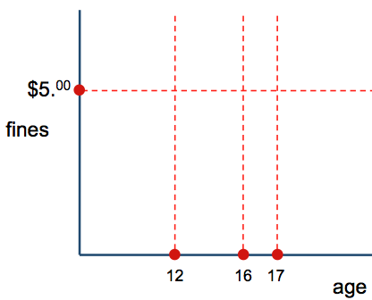
What is boundary testing?
WHICH BRINGS US BACK TO...
12 yrs, 1 day
Check fines
$5.⁰¹
Check PG-13 DVDs
fines
Check R-rated DVDs
$4.⁹⁹
Check Eminem CDs
11 yrs, 364 days
Questions?
12
16
17
age
Why not...
Preconditions:
Why do I like Kim Paxton more than Sandy Waters?
Where should we test?
Just inside
Just outside
On
WHY?

